Slide 1
Decennial Census Digitization and Linkage Project
November 2021
Katie Genadek Trent Alexander
U.S. Census Bureau University of Michigan
Any conclusions expressed herein are those of the authors and do not necessarily represent the views of the U.S. Census Bureau. All results were approved for release by the Census Bureau’s Disclosure Review Board (CBDRB-FY21-ERD002-022).

Slide 2
Overview
Background
Record linkage at the Census Bureau
Pilot project results
Project status

Slide 3
Available large-scale U.S. Census linkages
2000 census
2010 census
ACS
IPUMS Linked Samples
NBER Census Linking Project
1850-1940
1850 | 1860 | 1870 | 1880 | 1890 | 1900 | 1910 | 1920 | 1930 | 1940 | 1950 | 1960 | 1970 | 1980 | 1990 | 2000 | 2010 | 2020
3

Slide 4
Available large-scale U.S. Census linkages
1940 census
2000 census
2010 census
ACS
IPUMS Linked Samples
NBER Census Linking Project
1850-1940
1850 | 1860 | 1870 | 1880 | 1890 | 1900 | 1910 | 1920 | 1930 | 1940 | 1950 | 1960 | 1970 | 1980 | 1990 | 2000 | 2010 | 2020
4

Slide 5
Available large-scale U.S. Census linkages
1940 census
2000 census
2010 census
ACS
IPUMS Linked Samples
NBER Census Linking Project
1850-1940
1850 | 1860 | 1870 | 1880 | 1890 | 1900 | 1910 | 1920 | 1930 | 1940 | 1950 | 1960 | 1970 | 1980 | 1990 | 2000 | 2010 | 2020
5

Slide 6
Why is this difficult?
Microdata files for 1960-1990 exist but do not include names
Names were handwritten on census forms
Census forms are stored on 250,000 microfilm reels
Forms and data are highly restricted to protect respondent confidentiality
6

Slide 7
Overview
Background
Record linkage at the Census Bureau
Pilot project results
Project status

Slide 8
How the Census Bureau links records
All cases linked to a common composite or reference file of administrative records
Linkage with name, date of birth, sex, birthplace, address
Uses standard techniques of data cleaning and probabilistic matching
Matched cases are assigned a “Protected Identification Key” (PIK)

Slide 9
Administrative data coverage: availability and gaps
Easiest to assign PIKs:
Taxpayers
Workers
Persons on Medicare (most of the 65+ population)
Persons receiving housing/medical/food assistance
Men who ever registered for Selective Service
Harder to assign PIKs:
Mobile and transient populations
Residents without SSN
Children not claimed on tax forms

Slide 10
Linkage rates for decennial censuses
 | Records with PIK assigned | % of all records with PIK
2010 Census | 283,000,000 | 91%
2000 Census | 249,000,000 | 89%
1940 Census | 54,000,000 | 41%
10

Slide 11
Overview
Background
Record linkage at the Census Bureau
Pilot project results
Project status

Slide 12
1990 Pilot Project
Can we capture handwritten names with machines?
Scan the original forms from microfilm
Conduct Optical Character Recognition
Create truth data
Evaluate output

Slide 13
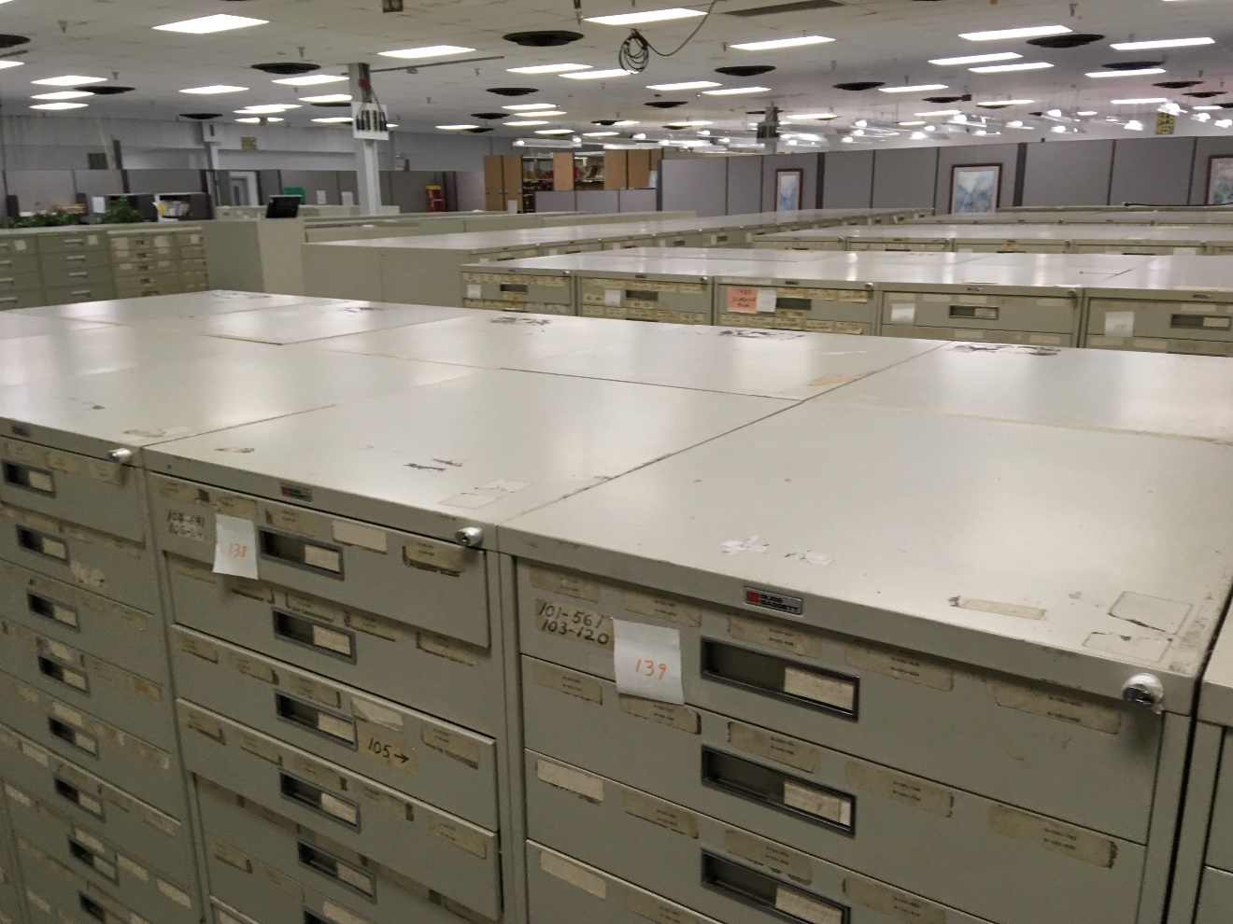
DRB approval numbers of CBDRB-FY19-204, CBDRB-FY20-ERD002-010
13

Slide 14
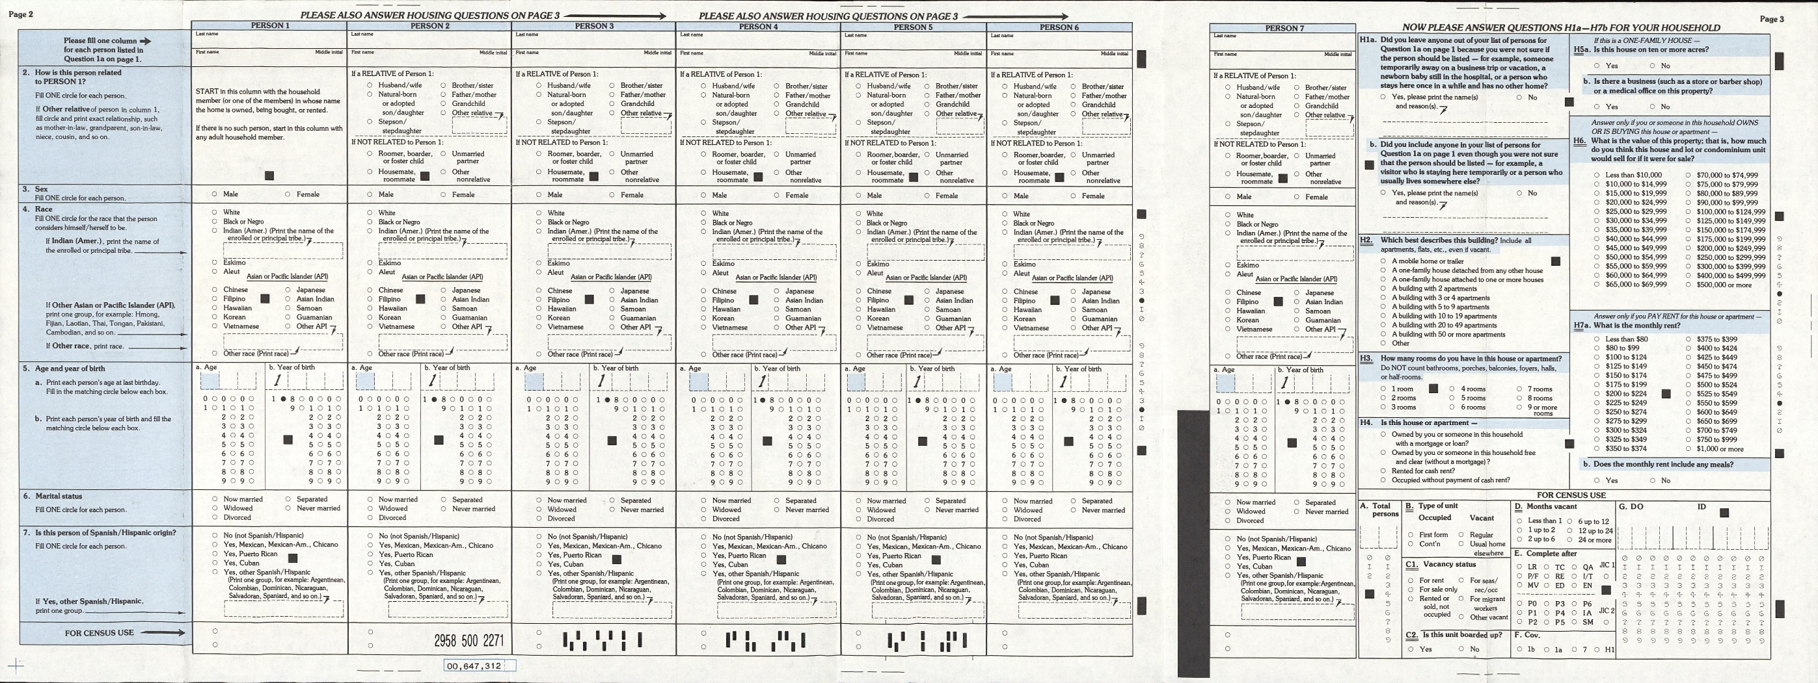
14

Slide 15
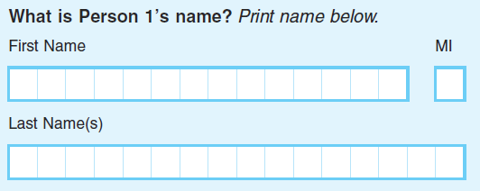
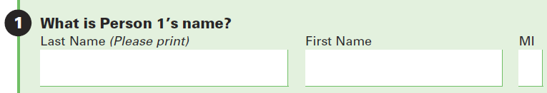
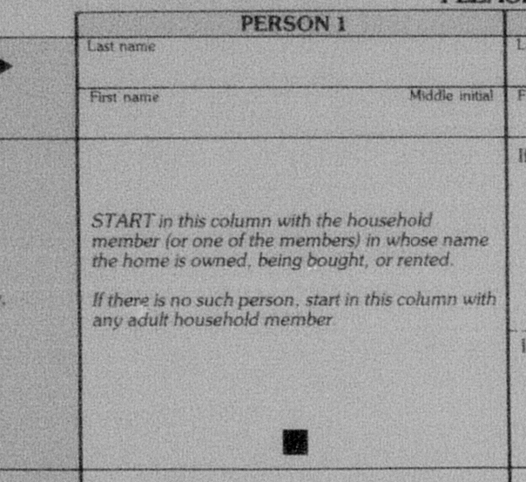
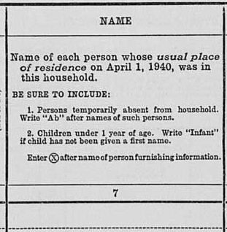
2020 Census
American Community Survey
1990 Census
1940 Census
15

Slide 16
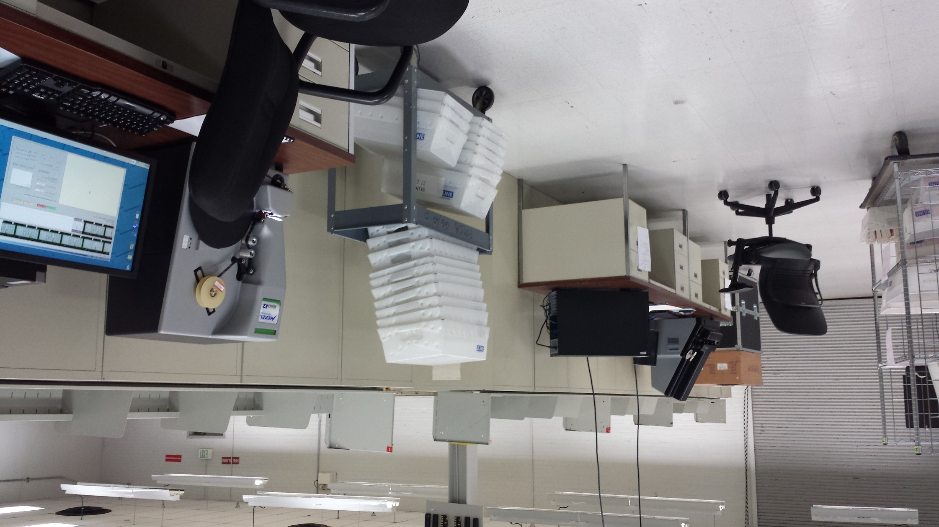
Scanning forms from microfilm
DRB approval numbers of CBDRB-FY19-204, CBDRB-FY20-ERD002-010
16

Slide 17
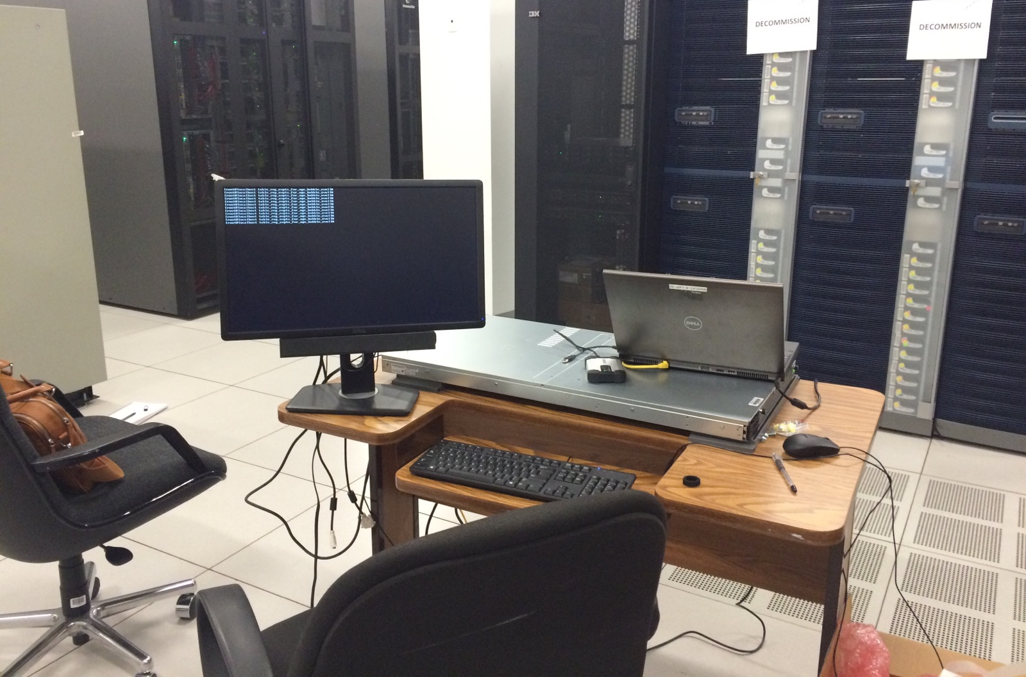
Conducting Optical Character Recognition
17

Slide 18
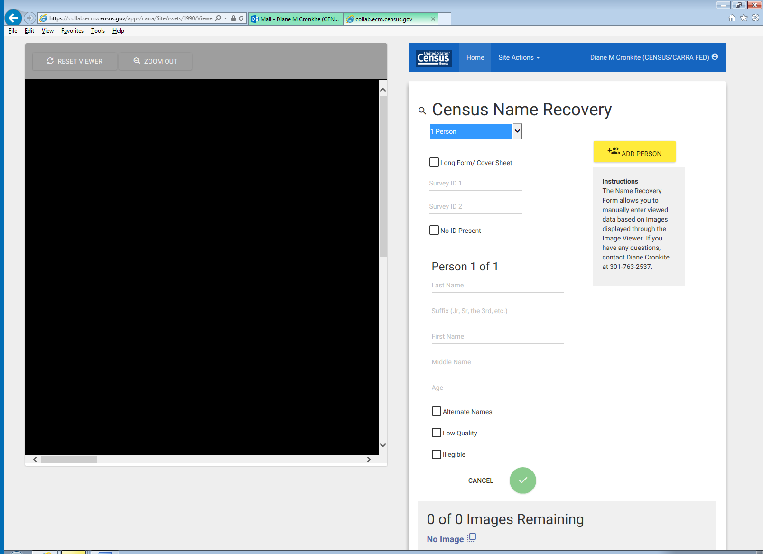
Creating Ground Truth Data

Slide 19
Evaluating output How often did OCR results match the Ground Truth?
19

Slide 20
Evaluating output How often did OCR results match the Ground Truth?
 | exact match |  | n
Age | 95% |  | 8,900
20

Slide 21
Evaluating output How often did OCR results match the Ground Truth?
 | exact match |  | n
Age | 95% |  | 8,900
Last Name | 82% |  | 8,850
*All results were approved for release by the Census Bureau’s Disclosure Review Board (CBDRB-FY21-ERD002-022).
21

Slide 22
Evaluating output How often did OCR results match the Ground Truth?
 | exact match |  | n
Age | 95% |  | 8,900
Last Name | 82% |  | 8,850
First Name | 75% |  | 8,850
*All results were approved for release by the Census Bureau’s Disclosure Review Board (CBDRB-FY21-ERD002-022).
22

Slide 23
Evaluating output How often did OCR results match the Ground Truth?
 | exact match | very similar* | n
Age | 95% |  | 8,900
Last Name | 82% | 90% | 8,850
First Name | 75% | 86% | 8,850
*Score of >0.85 on the Jaro-Winkler string comparator
*All results were approved for release by the Census Bureau’s Disclosure Review Board (CBDRB-FY21-ERD002-022).
23

Slide 24
Overview
What we are doing
Record linkage at the Census Bureau
Expanding the infrastructure
Project status

Slide 25
1960-1990 recovery started in June 2021
1940 census
2000 census
2010 census
ACS
IPUMS Linked Samples
NBER Census Linking Project
1850-1940
1850 | 1860 | 1870 | 1880 | 1890 | 1900 | 1910 | 1920 | 1930 | 1940 | 1950 | 1960 | 1970 | 1980 | 1990 | 2000 | 2010 | 2020
25

Slide 26
Expected Longitudinal Infrastructure by 2026
1850-2020 Decennial Censuses
Major Federal Surveys
American Community Survey (2001-present)
Current Population Survey (1973, 1978-present)
American Housing Survey (1983-present)
Survey of Income and Program Participation (1984-present)
Administrative Records
Examples: SSA Numident, Medicare, Medicaid
User-provided Data
Examples: clinical trials, administrative records, surveys
26

Slide 27
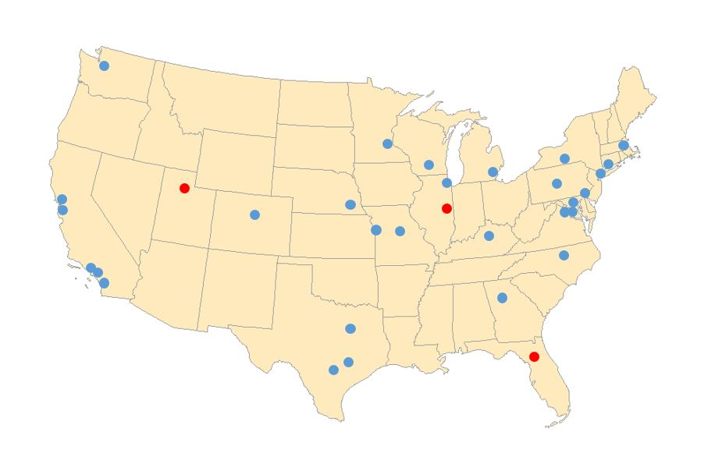
Federal Statistical Research Data Centers

Slide 28


Questions?
Katie Genadek
katie.r.genadek@census.gov
Trent Alexander
jtalex@umich.edu

